Slide 1
Data Access Layer

Slide 2
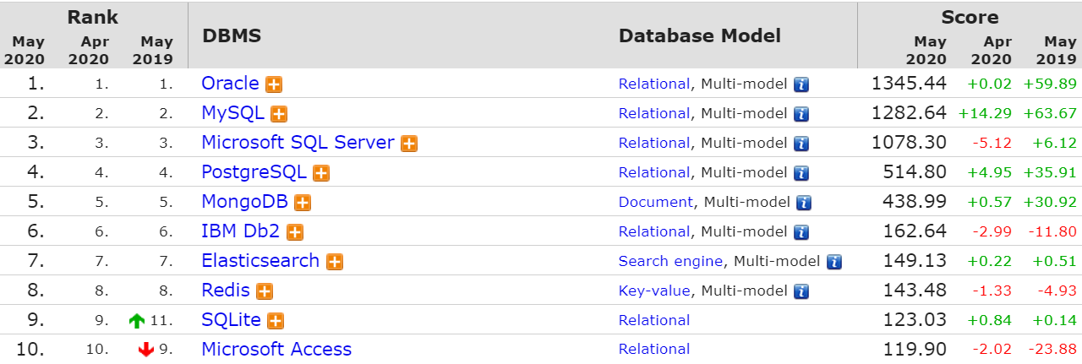
Top 10 DB

Slide 3
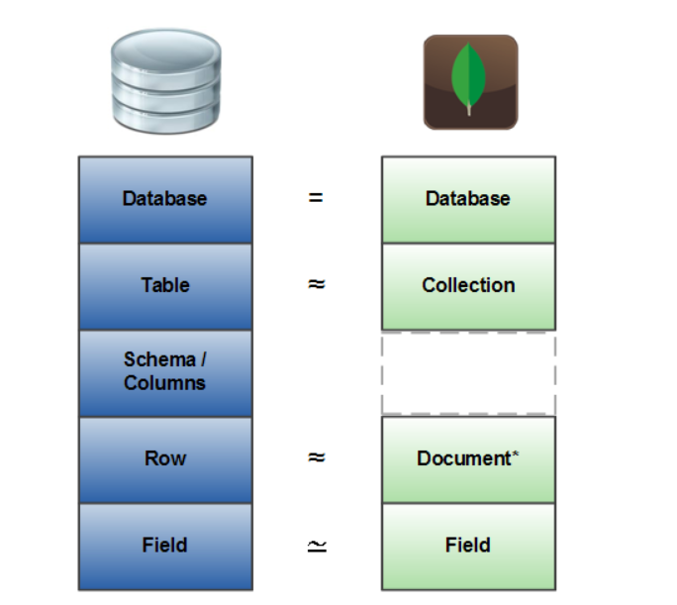
Mongo VS Relational DB

Slide 4
EF Core

Slide 5
DB Creation from objects

Slide 6
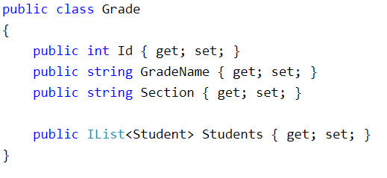
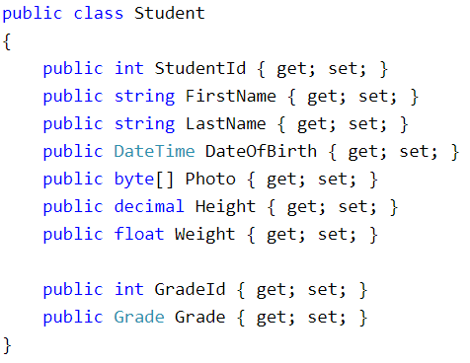
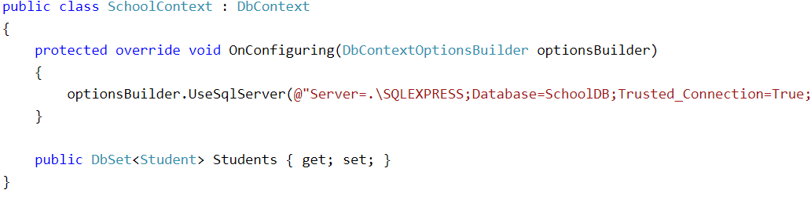

Slide 7
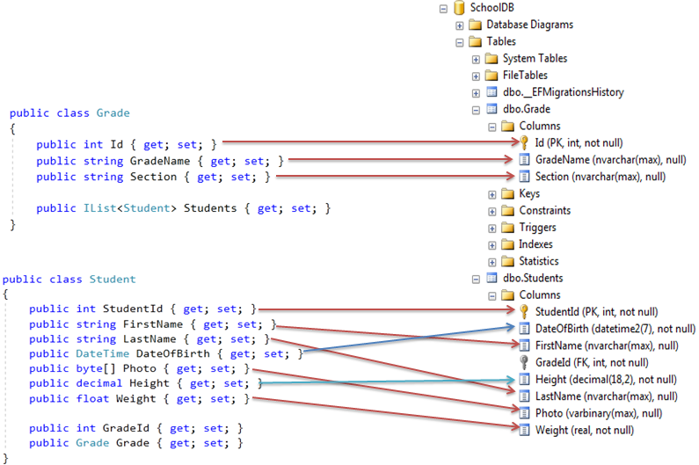
Columns/fields

Slide 8
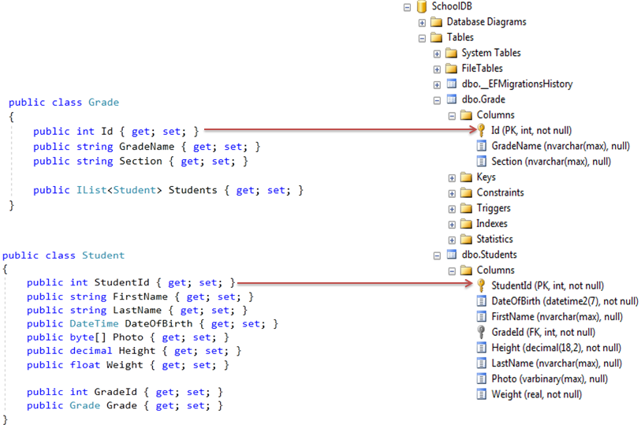
Primary key

Slide 9
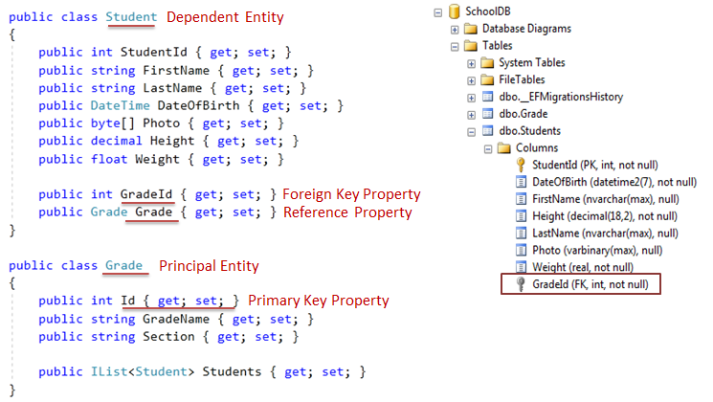
Foreign key

Slide 10
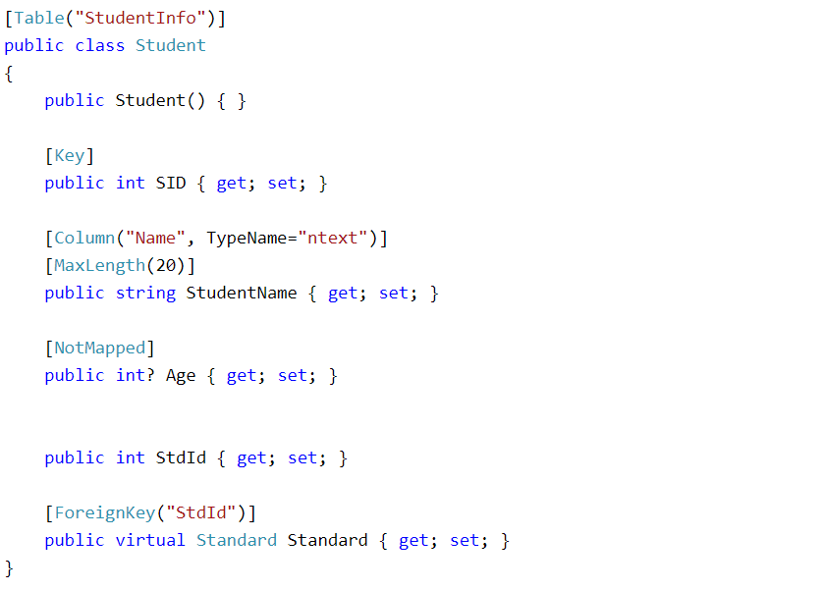
Data Annotation Attributes

Slide 11
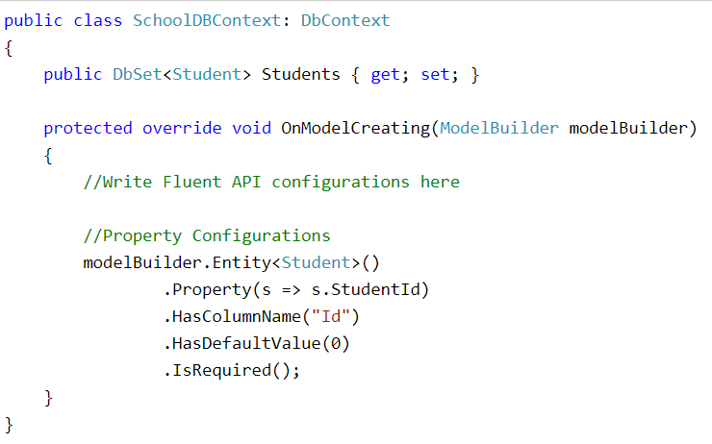
Manual Configurations

Slide 12
Queries

Slide 13
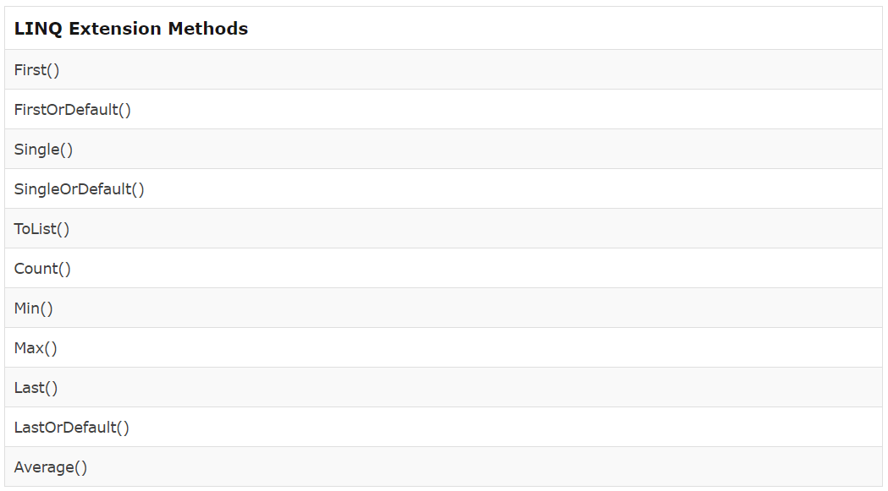

Slide 14
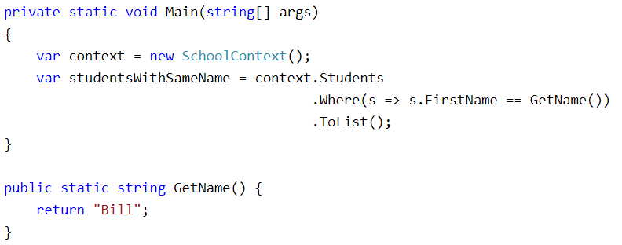
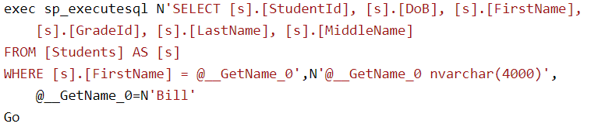
Examples

Slide 15
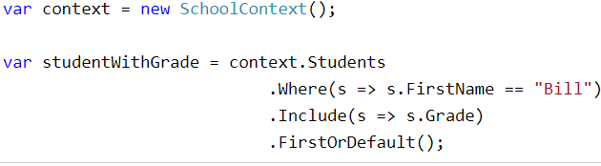
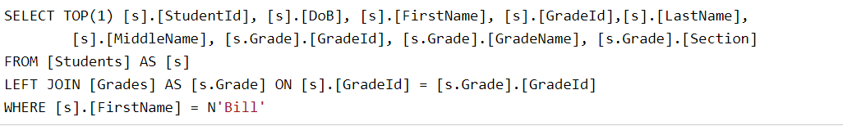
Examples

Slide 16
Insert Update Delete

Slide 17
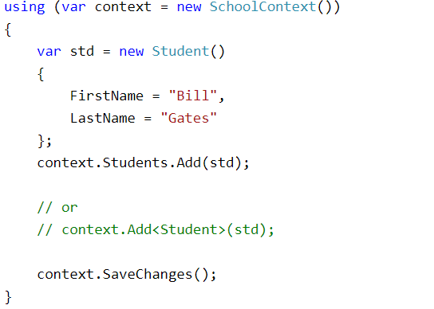
Insert

Slide 18
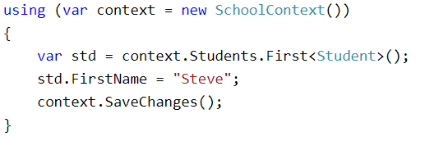
Update

Slide 19
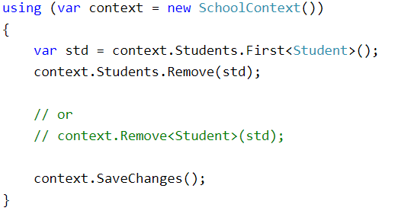
Delete

Slide 20
Inheritance

Slide 21
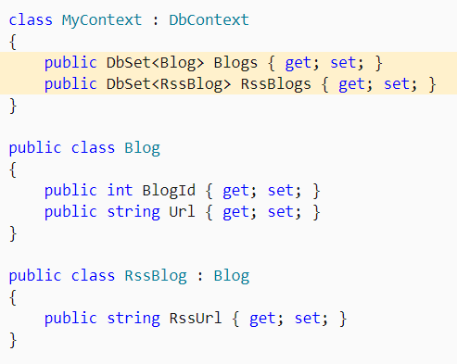
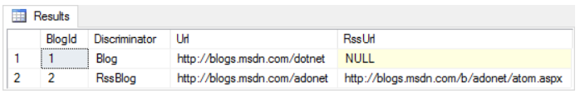

Slide 22
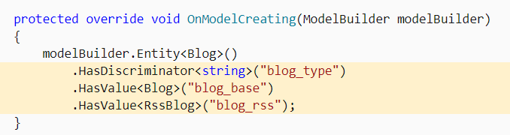
Manual discriminator

Slide 23
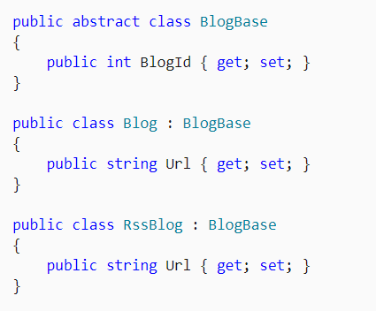
Siblings with same name property

Slide 24
Persistent VS non-persistent

Slide 25
EF Core tutorials
https://www.entityframeworktutorial.net/what-is-entityframework.aspx
https://docs.microsoft.com/en-us/ef/core/

